Slide 1



By: Vishal Gupta & Anmol Rajput

Slide 2
Contents:
Introduction to SonarQube
SQM (Software Quality Management)
Features of SonarQube
Benefits of SonarQube
Getting Started with SonarQube
Practical

Slide 3
1
Introduction to SonarQube
What is SonarQube?
SonarQube is an open-source platform developed by SonarSource for continuous inspection of code quality.
Sonar does static code analysis, which provides a detailed report of bugs, code smells, vulnerabilities, code duplications.
SonarQube also provides support for 27 different languages, including C, C++, Java, Javascript, PHP, GO, Python, and much more.
SonarQube also provides CI/CD integration, and gives feedback during code review with branch analysis and pull request decoration.

Slide 4
Why SonarQube?
Developers working with hard deadlines to deliver the required functionality to the customer. It is so important for developers that many times they compromise with the code quality, potential bugs, code duplications, and bad distribution of complexity.
Additionally, they tend to leave unused variables, methods, etc. In this scenario, the code would work in the desired way.
Problem
In order to achieve continuous code integration and deployment, developers need a tool that not only works once to check and tell them the problems in the code but also to track and control the code to check continuous code quality. To satisfy all these requirements, here comes SonarQube in the picture.
Solution

Slide 5
2
SQM (Software Quality Management)
What is SQM?
When creating software, the code should have the following characteristics:
The code should follow a specific convention
Checked for potential bugs and performance, security, or vulnerabilities issues
Is the code duplicated anywhere
Does the code make logical sense, or is it too complex
Does the public API have good documentation and comments
Does the code have unit tests
Doe the code follow good software design and architecture principles.

Slide 6
3
Features of SonarQube
Features of SonarQube are:
Doesn’t just show you what’s wrong, but also offers quality and management tools to actively helps you correct issues
Focuses on more than just bugs and complexity and offers more features to help the programmers write code, such as coding rules, test coverage, de-duplications, API documentation, and code complexity all within a dashboard
Gives a moment-in-time snapshot of your code quality today, as well as trends of past and potentially future quality indicators. Also provides metrics to help you make the right decisions

Slide 7
4
Benefits of SonarQube
Benefits of SonarQube :
Sustainability - Reduces complexity, possible vulnerabilities, and code duplications, optimizing the life of applications.
Increase productivity - Reduces the scale, cost of maintenance, and risk of the application; as such, it removes the need to spend more time changing the code
Quality code - Code quality control is an inseparable part of the process of software development.
Detect Errors - Detects errors in the code and alerts developers to fix them automatically before submitting them for output.
Increase consistency - Determines where the code criteria are breached and enhances the quality
Business scaling - No restriction on the number of projects to be evaluated
Enhance developer skills - Regular feedback on quality problems helps developers to improve their coding skills

Slide 8
5
Getting Started with SonarQube
Software Requirements:
1. Java (Oracle JRE 11/17 or OpenJDK 11/17) installed on your machine.
Link:- https://www.oracle.com/java/technologies/downloads/archive/
2. LTS version SonarQube Software (Recommended)
Link:- https://www.sonarqube.org/downloads/

Slide 9
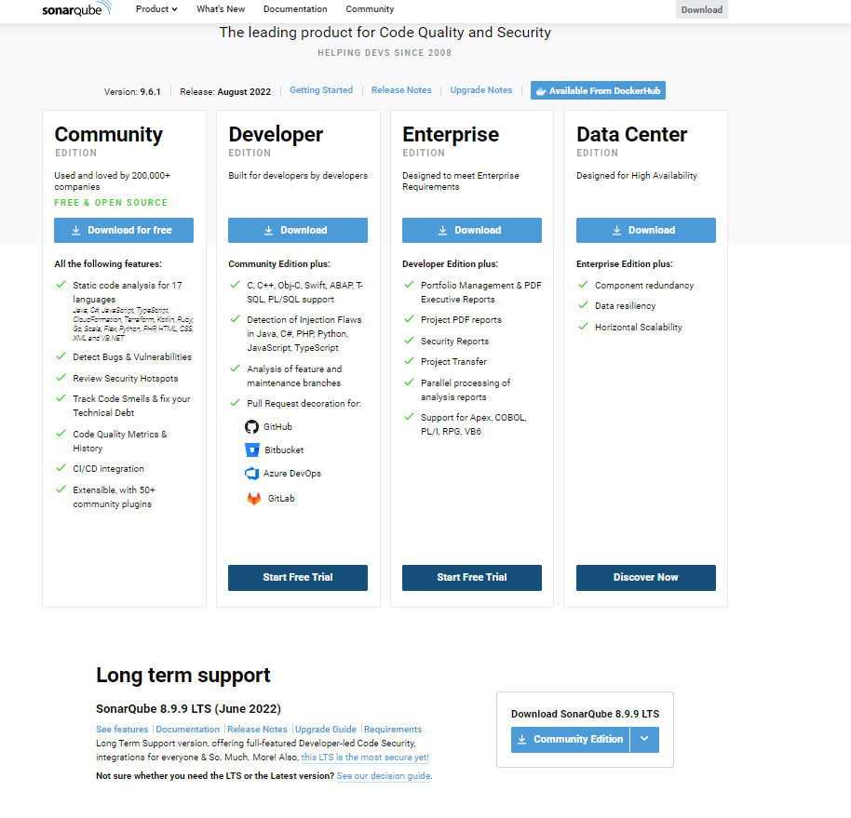
Step: 1
Download LTS Version of SonarQube Software
Link:- https://www.sonarqube.org/downloads/

Slide 10
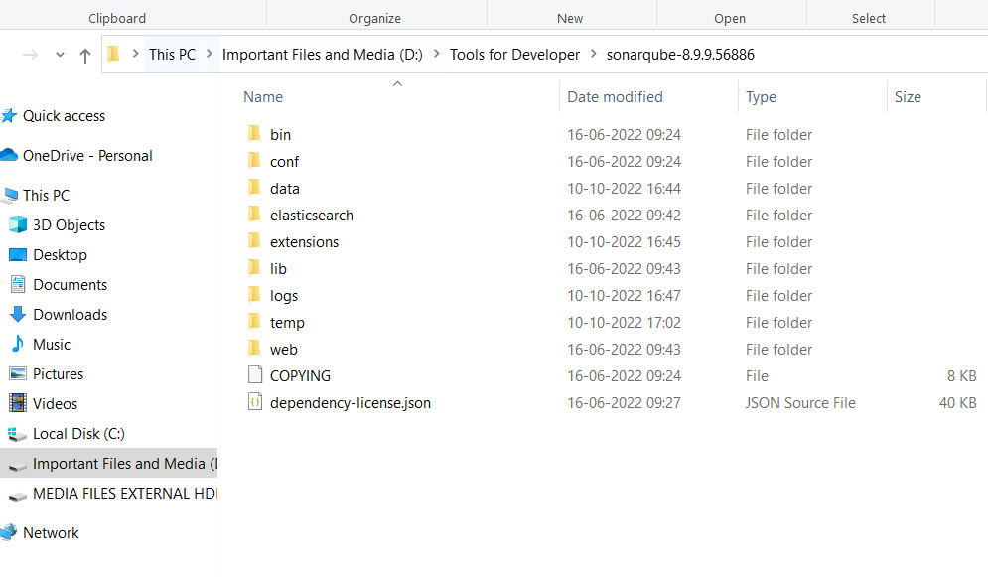
Step: 2
Extraction or Unzipping of SonarQube Software
Extract the file anywhere in the System
After Extraction click on the file you will see the below content

Slide 11
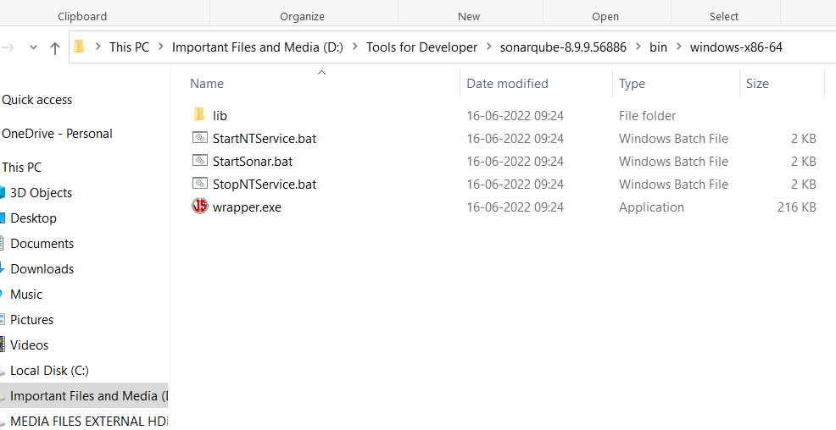
wrapper.java.command=C:/Program Files/Java/jdk-11.0.16/bin/java
Step: 3
Starting of SonarQube Software
Move to the specified directory as showen below

Slide 12
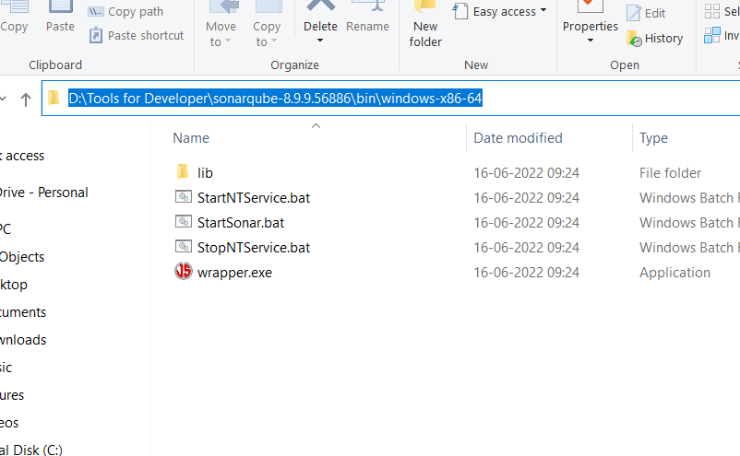
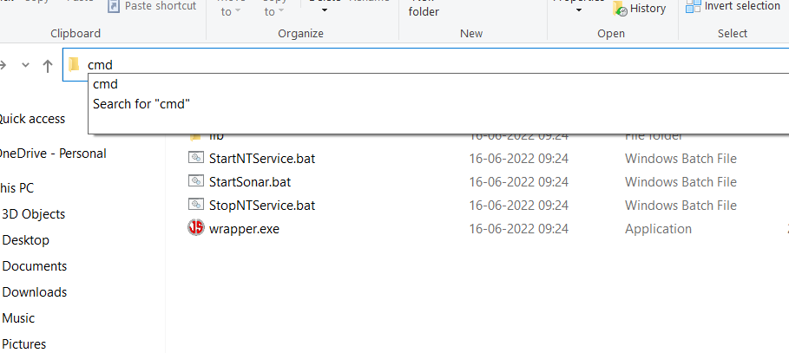
Select the path as shown in the picture
After Selecting the entire path type “cmd” and press Enter as show in the picture

Slide 13
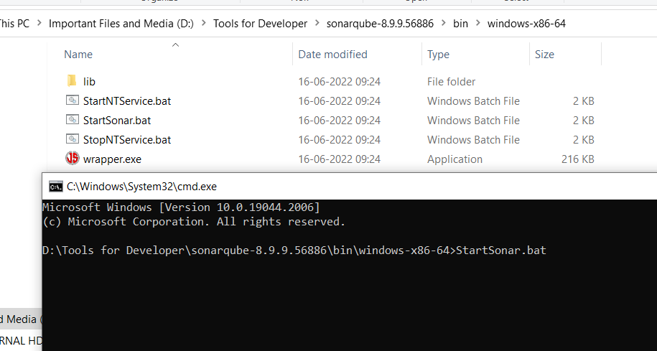
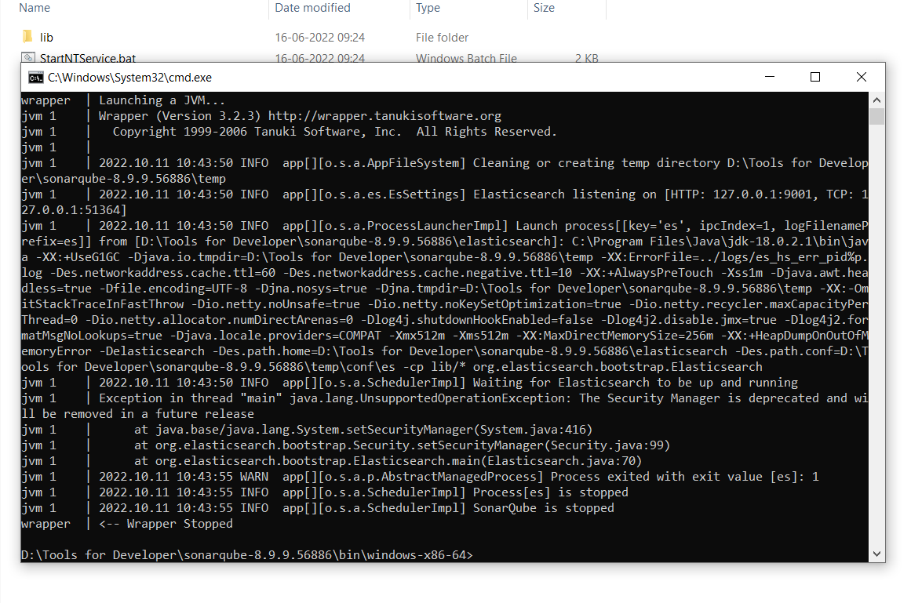
After command prompt opens type StartSonar.bat and hit enter
May be after start you will get the error as shown in the picture.
This might be because of
You have not installed the jdk 11 or 17.
Or
You have more than in jdk installed but 11 or 17 version not configured with Sonar.

Slide 14
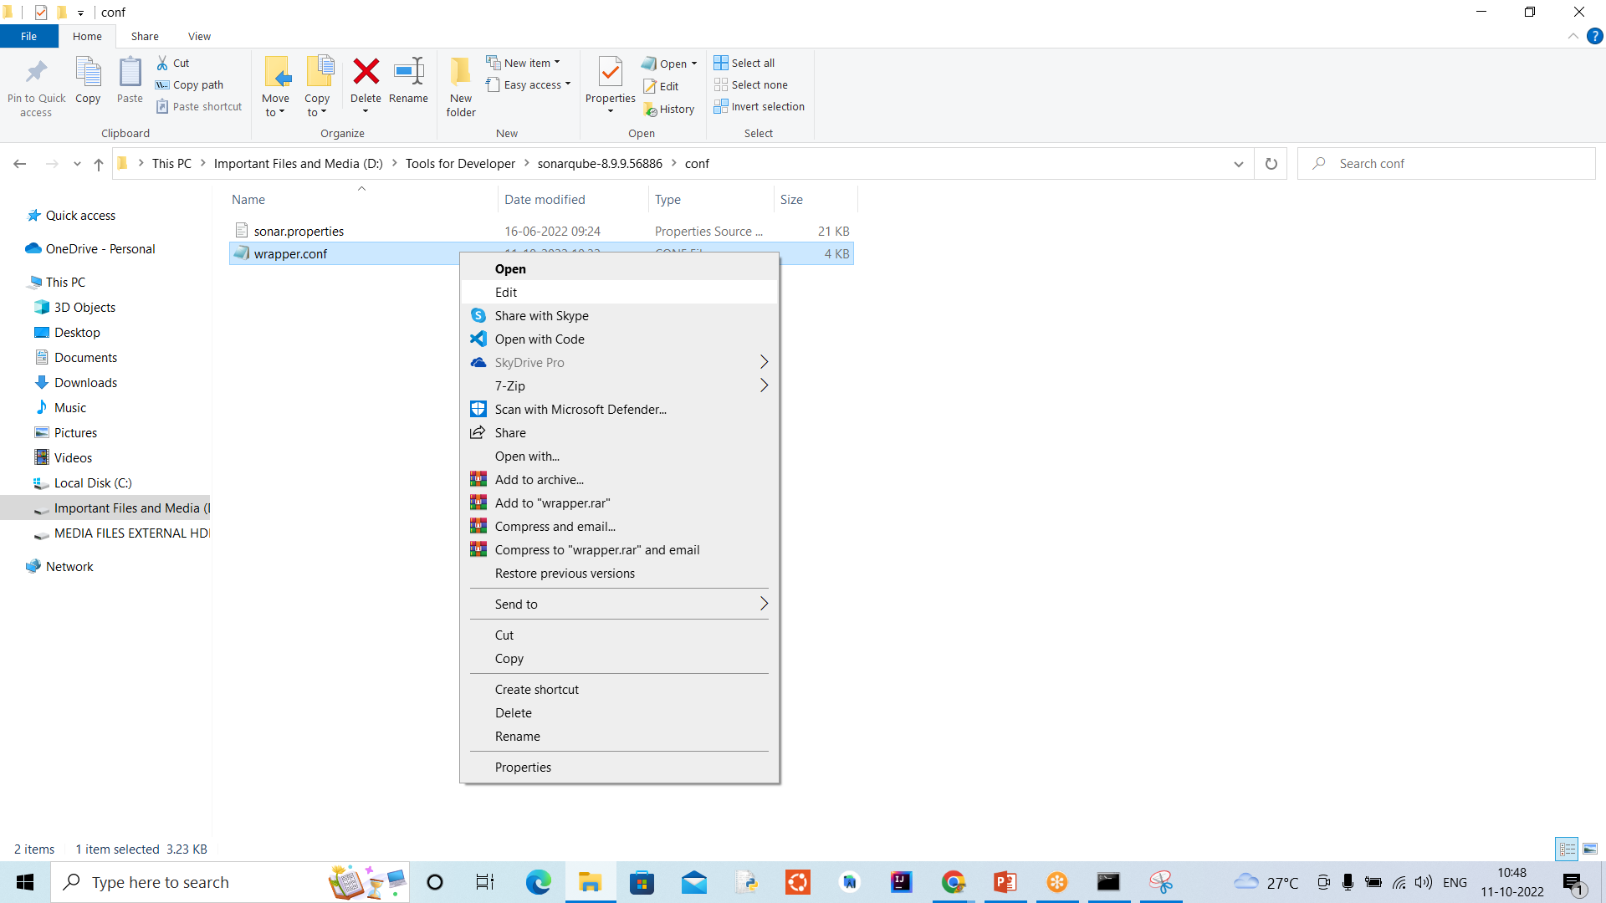
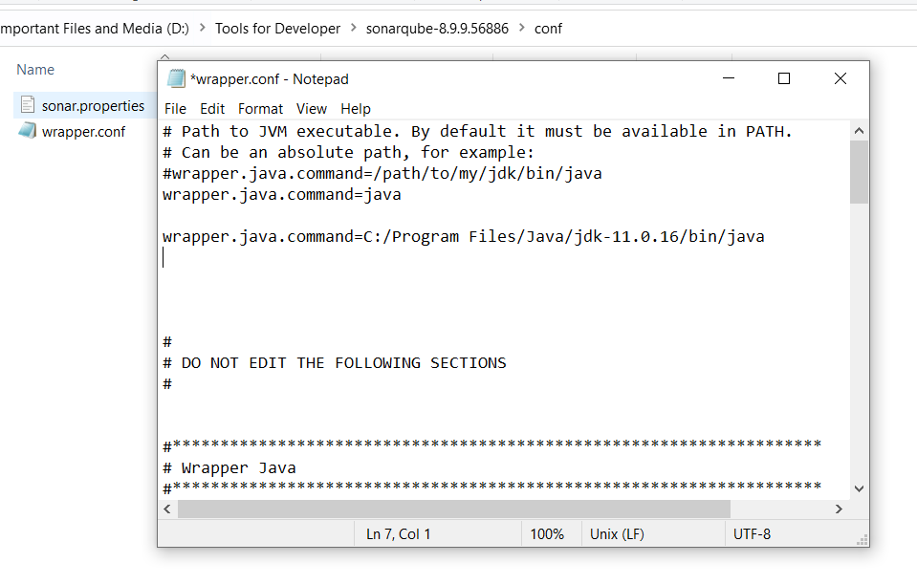
To configure jdk 11 or 17 with Sonar
Move to respected directory as showen in the picture
Open wrapper.conf file
Add the following command in the file
wrapper.java.command=C:/Program Files/Java/jdk-11.0.16/bin/java
Note: Once verify your path for java
Save the file and restart your SonarQube following previous step.

Slide 15
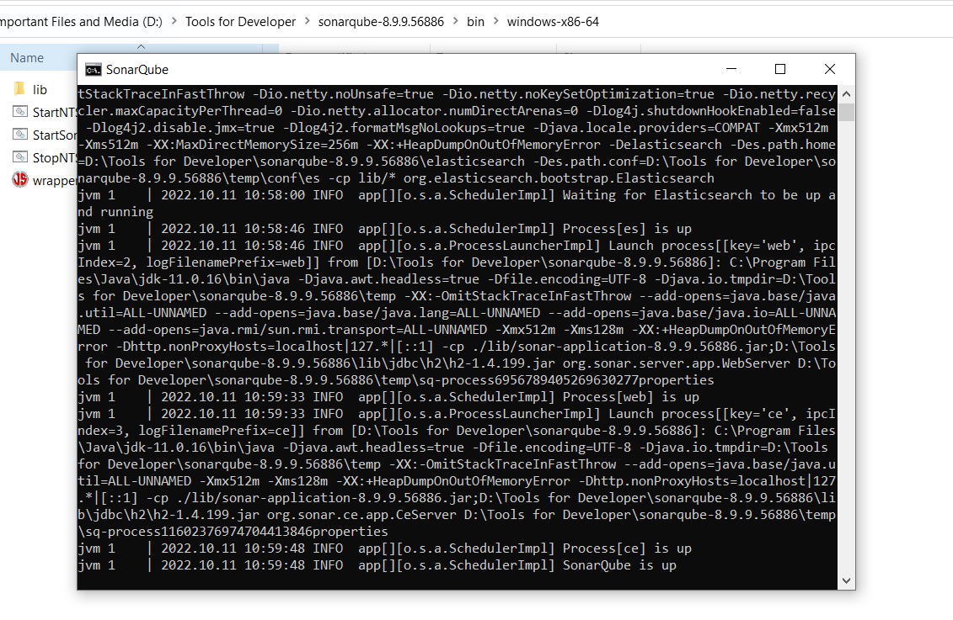
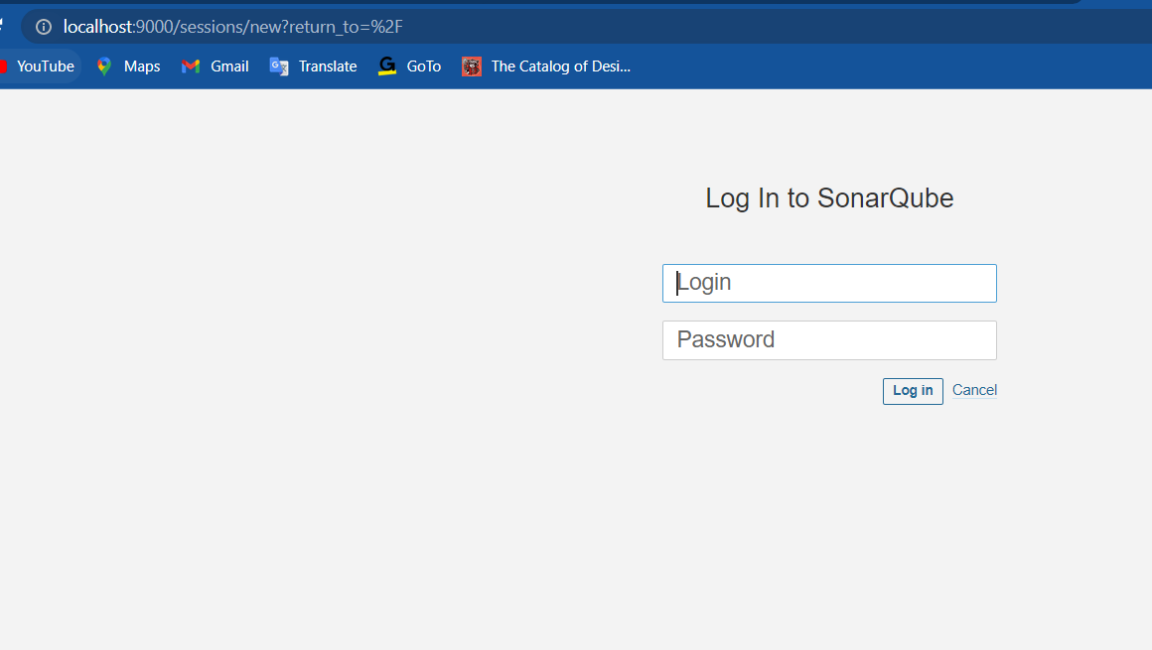
After starting the Sonar application this will looks like as shown in the picture.
In this you will see SonarQube is up now and
by default opens on localhost:9000
Go to browser and open
localhost:9000 and press enter
A Login page will appear as shown in the picture

Slide 16
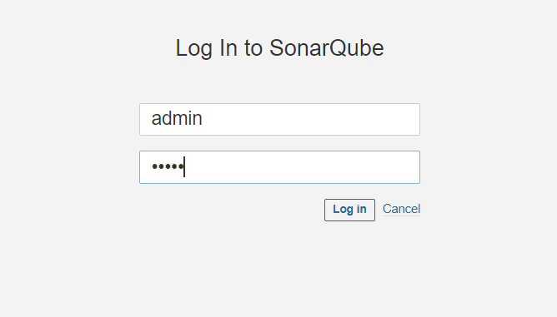
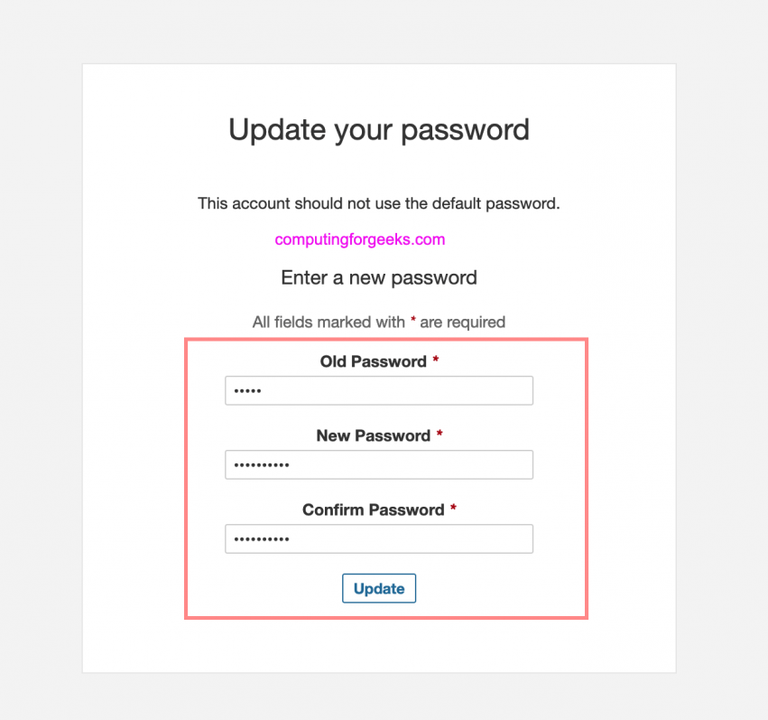
The default username and password is admin and admin
After that press login button
You will get this page where you have to reset your password
After resetting press update

Slide 17
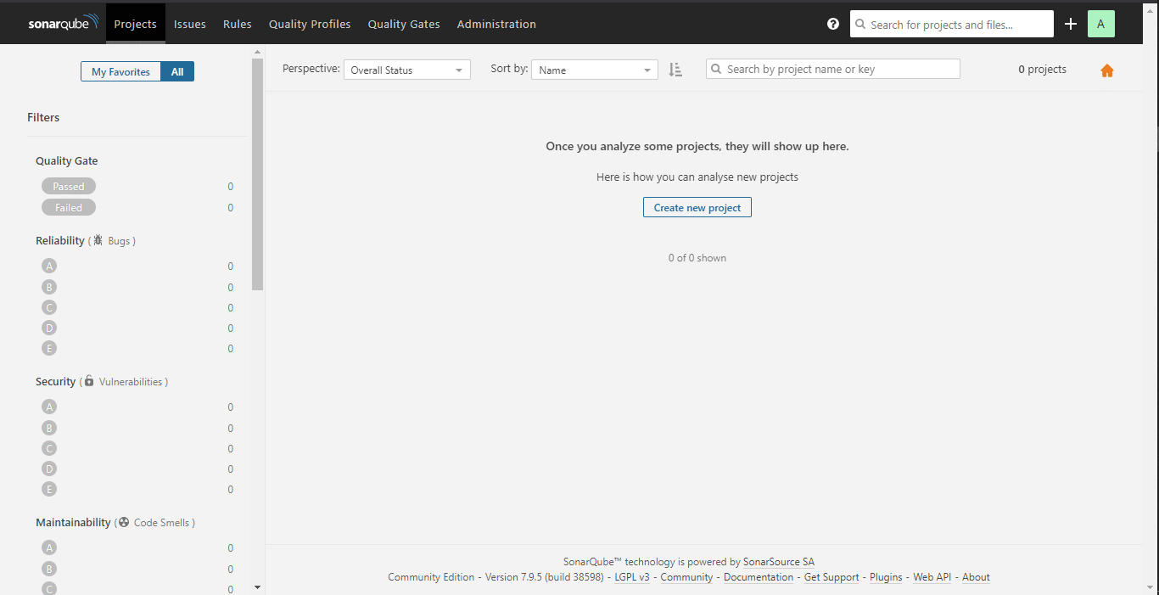
After updating you password you will see the Sonar Dashboard where we have to add our project.

Slide 18
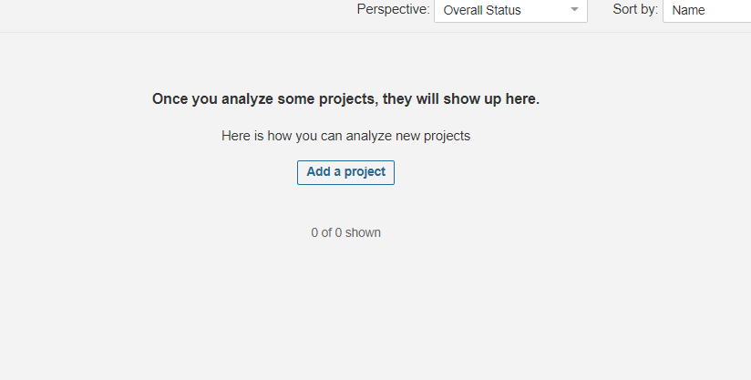
Step: 4
Generating token for Project
Now click on Add a project to generate Token

Slide 19
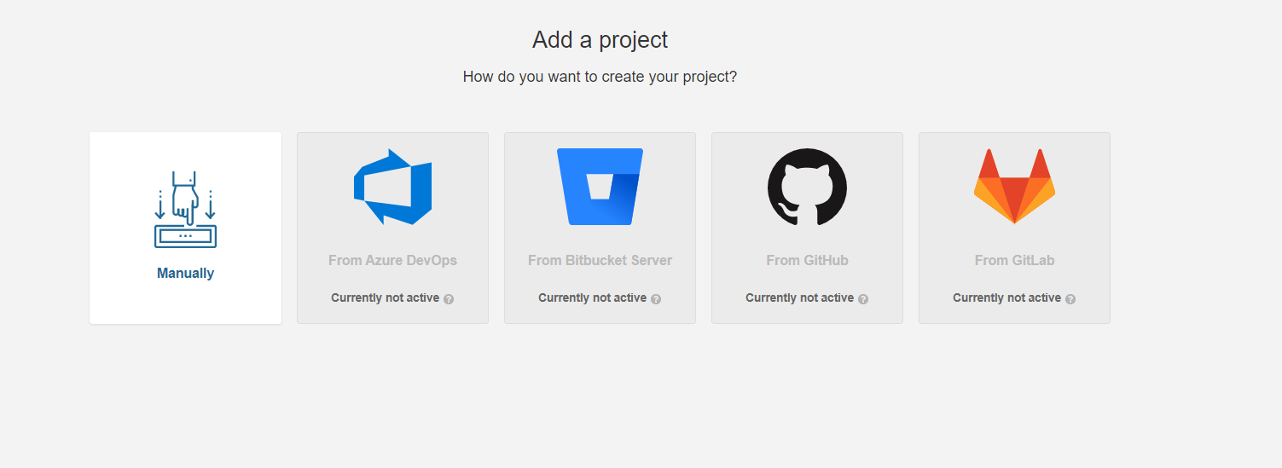
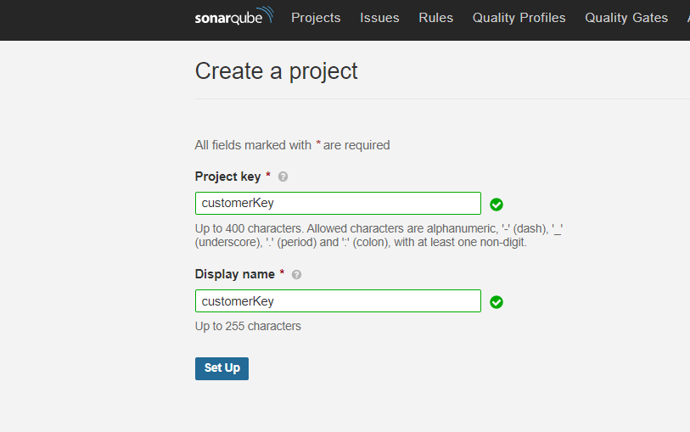
After that this page will appear
Select Manually option
Enter any text in ProjectKey
And click on Set Up

Slide 20
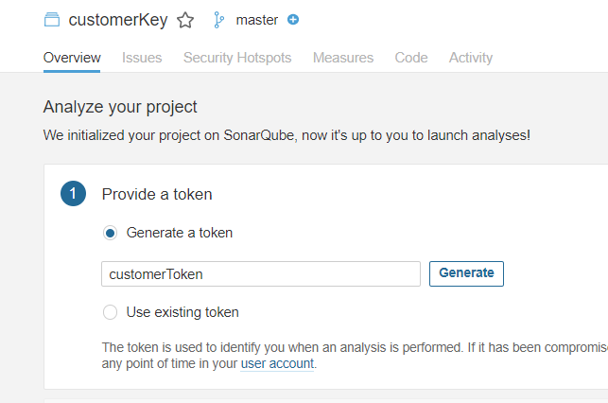
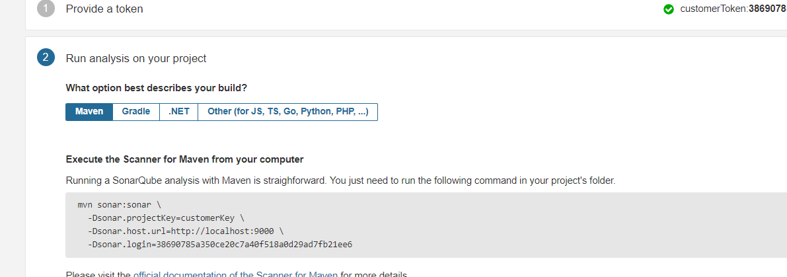
Enter any relevant text to Generate token
And Click on Generate Button
After token is generated click on Continue you will see different build options, select Maven build
You will see one mvn command.
This will be needed to connect our mvn project with Sonar

Slide 21
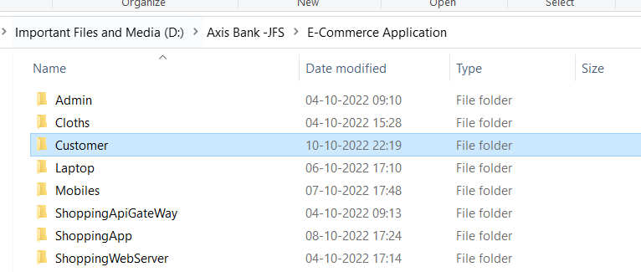
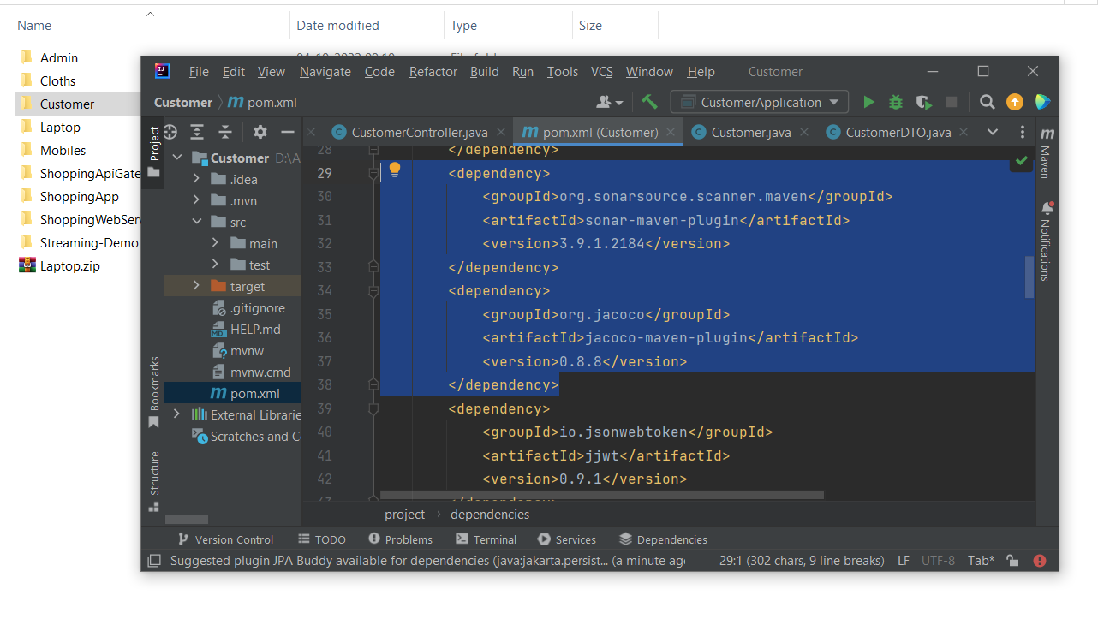
Generating Analysis Report of Our Project
Step: 5
Create one Java Application
In our case we have generated one Spring Boot Application
Open the application using IntelliJ
Here we are using IntelliJ for Spring Boot
Add these two dependencies in your pom.xml file

Slide 22
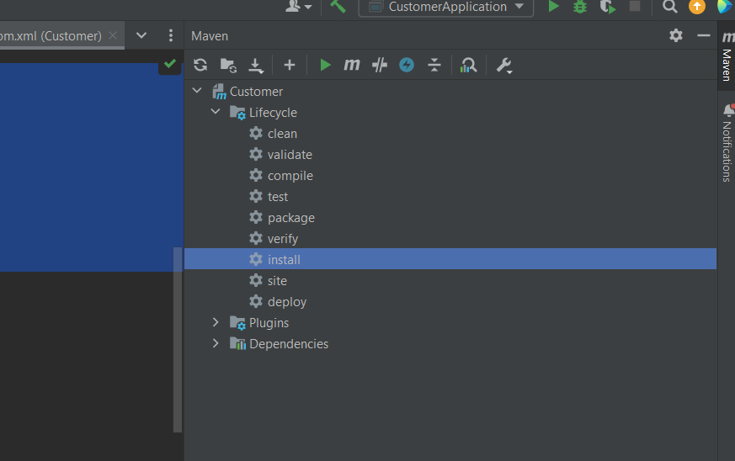
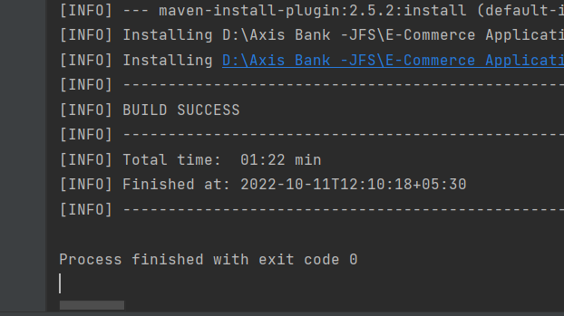
In rightmost side of intelliJ display you will find Maven option click on it
Under Lifecycle you will find install option double click on it to build and generate Jar file.
After Build is Success you can find one jar file in your target directory

Slide 23
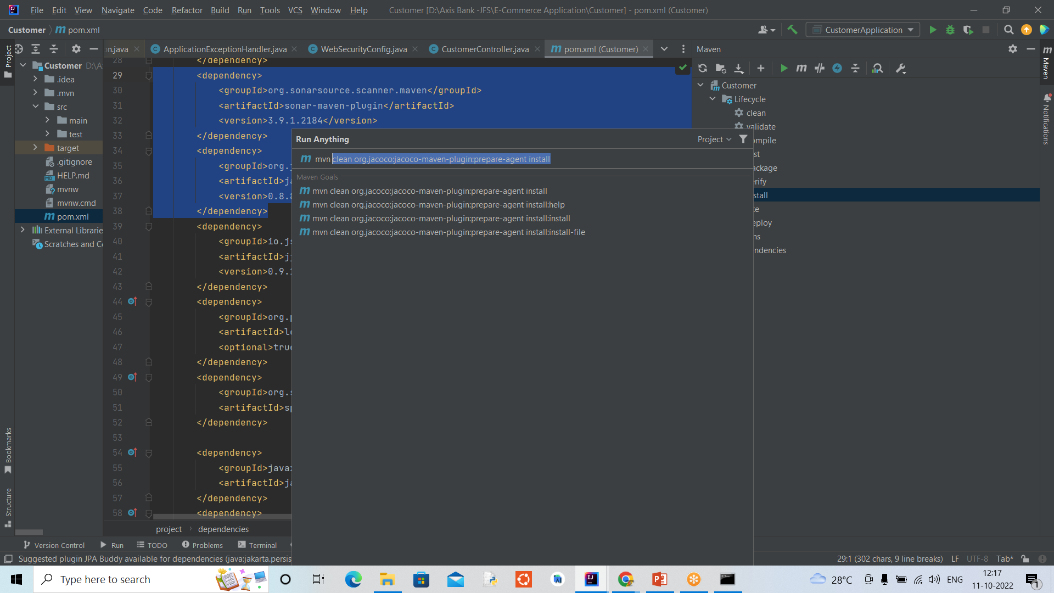
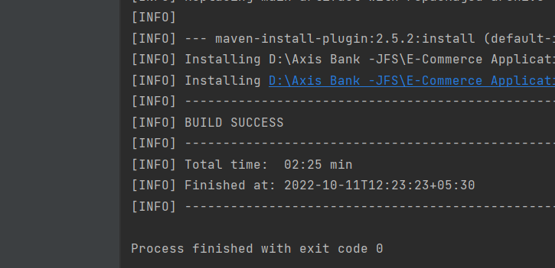
Now click on m logo in maven option t execute maven goal
And type
clean org.jacoco:jacoco-maven-plugin:prepare-agent install
And press Enter
After Build is Success again go to
execute maven goal

Slide 24
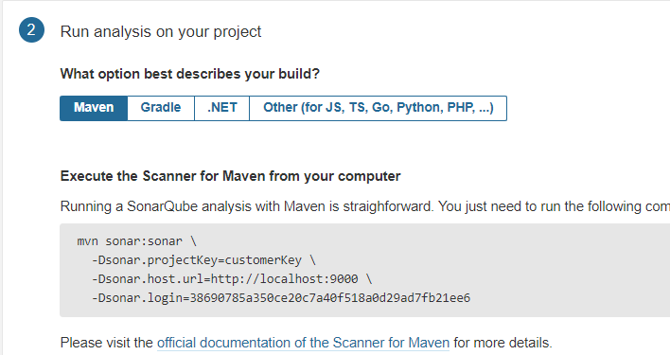
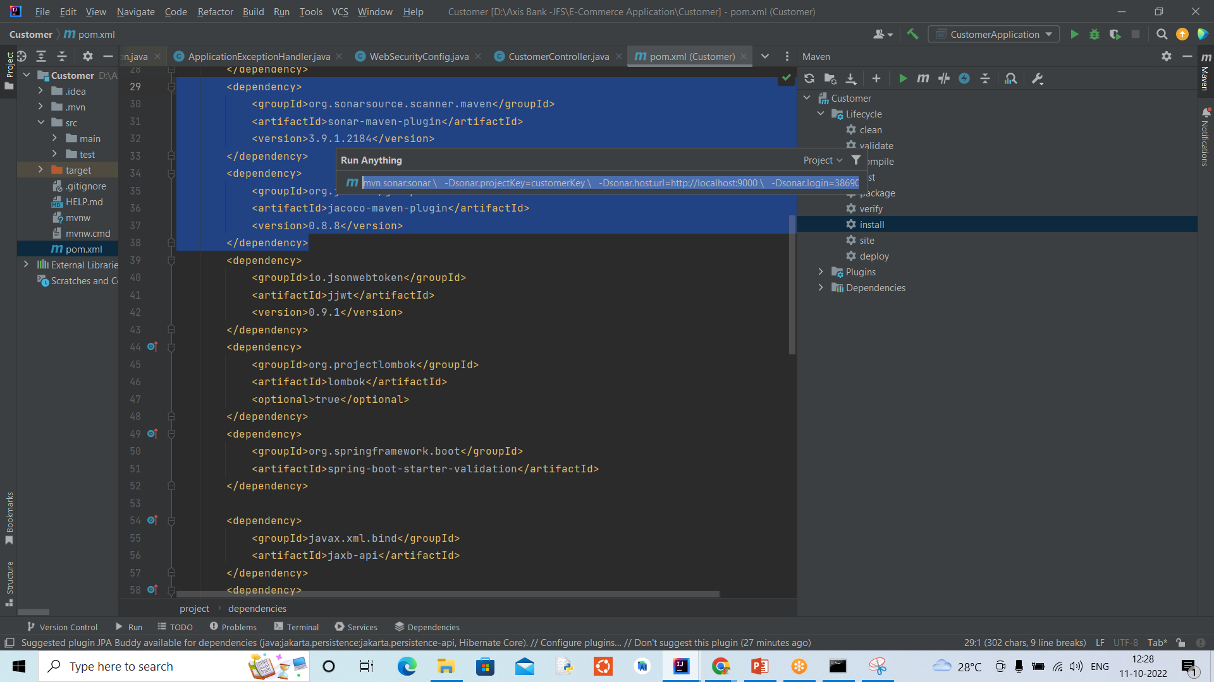
Go to Sonar Dashboard and copy the
mvn command as shown in picture
Paste the mvn command in the
execute maven goal panel and press enter

Slide 25
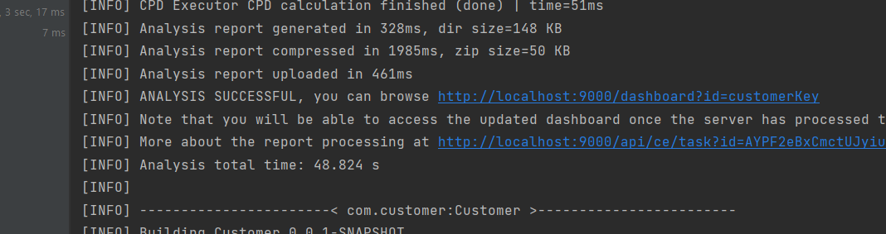
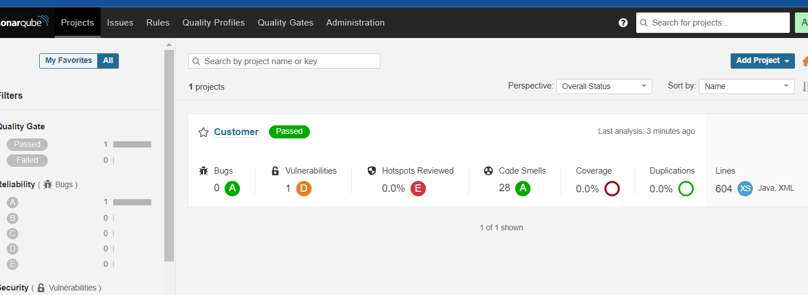
Here you can see in the picture that
Analysis report generated successfully.
Now go to browser and refresh you page and go to Project
Here you can see your Analysis Report is Generated.
Now Click on your project to review your Report.

Slide 26
6
Practical
Let’s do

Slide 27
Thank You

